Slide 1
Object Oriented Programming Lecture - 3
Prof. Varsha Dange

Slide 2
Java Naming conventions
Java naming convention is a rule to follow as you decide what to name your identifiers such as class, package, variable, constant, method, etc.
But, it is not forced to follow. So, it is known as convention not rule.
Class -It should start with the uppercase letter.
Interface -It should start with the uppercase letter.

Slide 3
Java Naming conventions
Method-It should start with lowercase letter.
Variable
It should start with a lowercase letter such as id, name.
It should not start with the special characters like & (ampersand), $ (dollar), _ (underscore).
Package -It should be a lowercase letter such as java, lang.
CamelCase in java naming conventions
Java follows camel-case syntax for naming the class, interface, method, and variable.
If the name is combined with two words, the second word will start with uppercase letter always such as actionPerformed(), firstName, ActionEvent, ActionListener, etc.

Slide 4
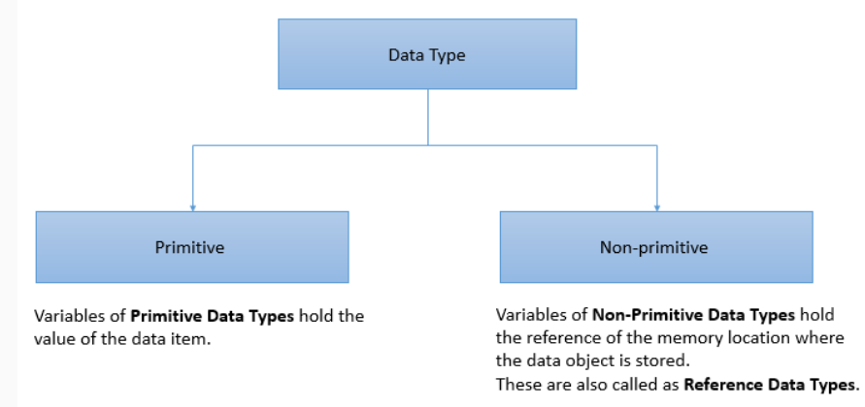
Data Types in Java
Data type defines the type of data that can be stored in the variable and the memory required by it.

Slide 5
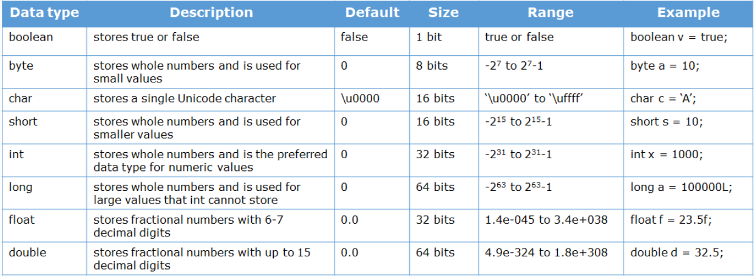
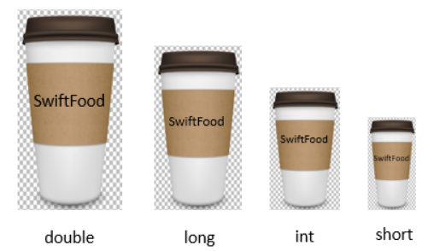
Data Types in Java

Slide 6
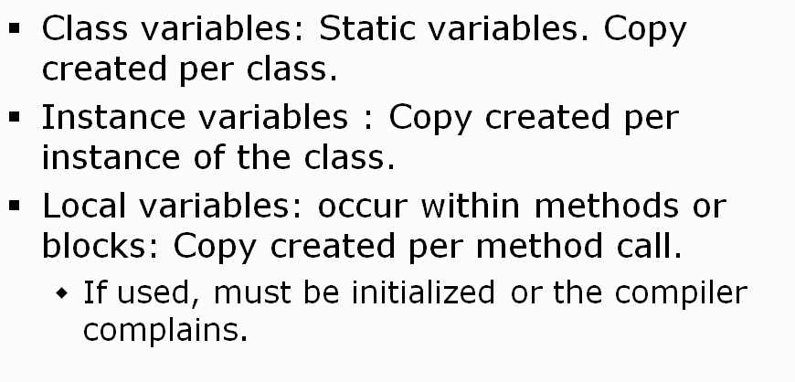
Variables in Java
Data is stored in variables.
A variable is a named memory location which holds some value.

Slide 7
instance Variables
A variable which is created inside the class but outside the method is known as an instance variable.
Instance variable doesn't get memory at compile time.
It gets memory at runtime when an object or instance is created.

Slide 8
Instance Block
block in Java is a set of code enclosed within curly braces { } within any class, method, or constructor.
Instance Initialization Blocks or IIB are used to initialize instance variables . It is also known as non-static block .
It will be executed after the execution of the static block if any static block is declared inside the class.
Instance block executes before the constructor only when an instance of the class is created.
They run each time when object of the class is created. Example
We can also have multiple IIBs in a single class.

Slide 9
Static
The static can be:
Variable (also known as a class variable)
Method (also known as a class method)
Block
If you declare any variable as static, it is known as a static variable.
The static variable can be used to refer to the common property of all objects (which is not unique for each object)
for example, the company name of employees, college name of students, etc.
we can access static variable, method, or block of the class without any object creation.

Slide 10
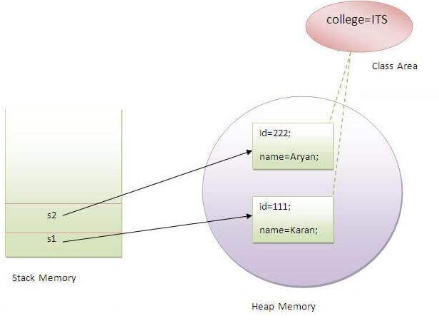
Static Variable
all instance data members will get memory each time when the object is created.
The static variable gets memory only once in the class area at the time of class loading.
It saves the memory .
A static variable can be accessed inside any other class using the class name. E.g- Student.collegeName;

Slide 11
Static Variable Initialization
Static variables in a class are initialized before the creation of any instance of that class.
Static variables in a class are initialized before the execution of any static method of the class. Therefore, we cannot initialize the static variable inside the static method.
If any object changes the value of the static variable, it will retain its value and increments by 1 for every object creation.
Example1(static use)
Example2(counter)

Slide 12
Static block
Is used to initialize the static data member.
It is executed before the main method at the time of class loading.
This code inside static block is executed only once.
static blocks are executed before constructors.
A class can have any number of static initialization blocks.
They are called in the order that they appear in the source code.
Example
Example(Before Main)

Slide 13
Static Method
If you apply static keyword with any method, it is known as static method.
It belongs to the class rather than the object of a class.
can be invoked without creating an object of a class.
They are referenced by the class name itself .
ClassName.methodName().
A static method can access only static data. It cannot access non-static data (instance variables).
this and super keyword cannot be used in static context.
When we create a static method in the class, only one copy of the method is created in the memory and shared by all objects of the class.
Example

Slide 14
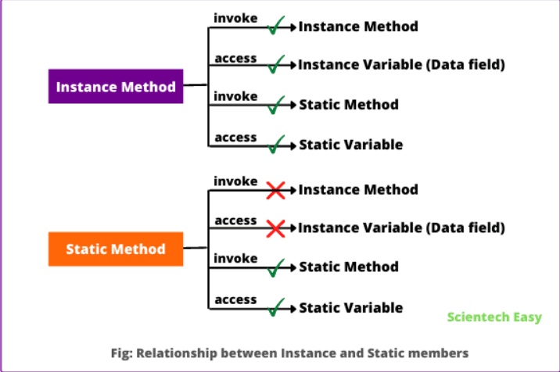

Static Method & Instance Method

Slide 15
Difference: Static Method & Instance Method
Sr No | Static Method | Instance Method
1. | A static method is also known as class method | the instance method is also known as non-static method.
2. | The only static variable can be accessed inside static method | static and instance variables both can be accessed inside the instance method.
3. | We do not need to create an object of the class for accessing static method | in the case of an instance method, we need to create an object for access.
4. | Class method cannot be overridden | an instance method can be overridden.
5. | Memory is allocated only once at the time of class loading | memory is allocated multiple times whenever the method is calling.

Slide 16
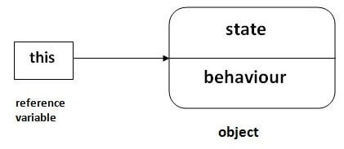
this Keyword
“this” is a keyword in Java is a reference variable that refers to the current class object.
In other words, it holds the reference to the current class object or the same class object.

Slide 17
this Keyword
Usage of Java this keyword
this can be used to refer current class instance variable.
this can be used to invoke current class method (implicitly)
this() can be used to invoke current class constructor.
this can be passed as an argument in the method call.
this can be passed as argument in the constructor call.
this can be used to return the current class instance from the method.

Slide 18
this Keyword
1) this: to refer current class instance variable
The this keyword can be used to refer current class instance variable.
If there is ambiguity between the instance variables and parameters, this keyword resolves the problem of ambiguity.
If local variables(formal arguments) and instance variables are different, there is no need to use this keyword.
Example without this
Example with this

Slide 19
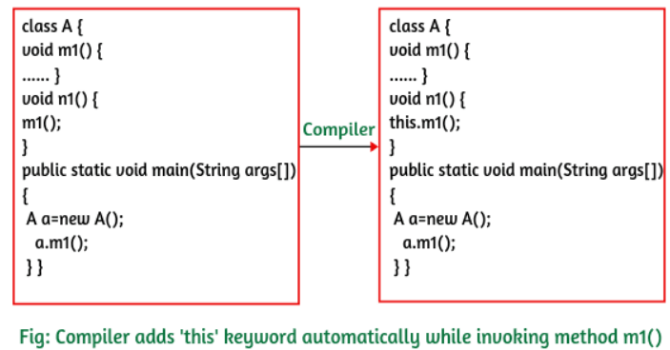
this Keyword
2) this: to invoke current class method
we may invoke the method of the current class by using the this keyword.
If we don't use the this keyword, compiler automatically adds this keyword while invoking the method.
Example :with this

Slide 20
this Keyword
3) this() : to invoke current class constructor
The this() constructor call can be used to invoke the current class constructor.
It is used to reuse the constructor.
In other words, it is used for constructor chaining.
The invocation of another constructor using ‘this’ keyword must be the first line of constructor only.
Example1
Example2

Slide 21
this Keyword
4) this: to pass as an argument in the method
The this keyword can also be passed as an argument in the method.
It is mainly used in the event handling.
Example
In event handling (or) in a situation where we have to provide reference of a class to another one.
It is used to reuse one object in many methods.

Slide 22
this Keyword
5) this: to pass as an argument in the Constructor call
We can also pass this keyword in the constructor call.
Example
This concept is useful when we have to use one object in multiple classes

Slide 23
this Keyword
6) this keyword can be used to return current class instance
We can return this keyword as an statement from the method. In such case, return type of the method must be the class type (non-primitive).
Example

Slide 24
main method
public static void main(String args[ ]) {
As a general rule, a Java program begins execution by calling main( ).
The public keyword is an access modifier, which allows the programmer to control the visibility of class members.
When a class member is preceded by public, then that member may be accessed by code outside the class in which it is declared.

Slide 25
main method
public static void main(String args[ ]) {
The keyword static allows main( ) to be called without having to instantiate a particular instance of the class.
This is necessary since main( ) is called by the Java Virtual Machine before any objects creation.
The keyword void simply tells the compiler that main( ) does not return a value.

Slide 26
main method
public static void main(String args[ ]) {
Any information that you need to pass to a method is received by variables specified within the set of parentheses that follow the name of the method.
These variables are called parameters.
If there are no parameters required for a given method, we still need to include the empty parentheses.
In main( ), there is only one parameter.
String args[ ] declares a parameter named args, which is an array of instances of the class String.

Slide 27
main method
public static void main(String args[ ]) {
One other point: main( ) is simply a starting place for your program.
A complex program will have dozens of classes, only one of which will need to have a main( ) method to get things started.

Slide 28
Object class in Java
There is one special class, Object, defined by Java.
Object is a root class of all other classes.
Every class in the java programming language is a subclass of Object class by default .
Object class is in the default package that is java.lang package .
The Object class defines the basic state and behavior that all objects must have,
such as the ability to compare oneself to another object,
to convert to a string, to wait on a condition variable,
to notify other objects that a condition variable has changed, and to return the object's class.

Slide 29
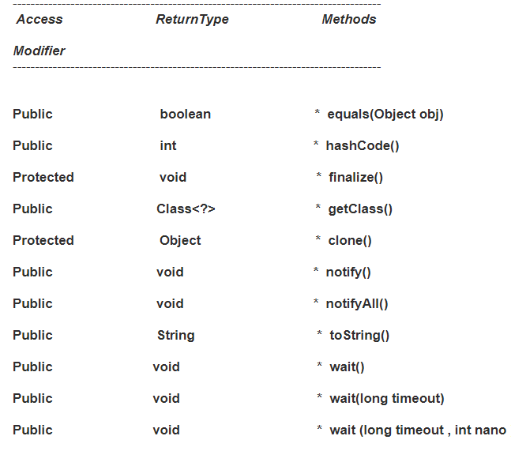
Object Class Methods

Slide 30
Object Class Methods
1. equals (Object obj) Checks whether the obj object is equal to the object on which the equals method is called . 2. hashCode() hashCode() is used for the HashTable . It returns the hash value of the object. 3. getClass() It returns the runtime class object . 4. clone() It creates and returns the copy of the object .

Slide 31
Object Class Methods
5. notify() It will wake up the thread waiting for the objects monitor. 6. notifyAll() It will wakes up all the thread that are waiting for the objects monitor . 7. toString() Example(without) Example(with) It will return the string representation of the object . 8. wait() This method causes the current thread to place itself in the wait set for this object and then to stop holding any and all synchronization claims on this object

Slide 32
Static class in Java
Java allows us to create a class within a class.
It provides a compelling way of grouping elements that are only going to be used in one place, this helps to keep our code more organized and readable.
The nested class architecture is divided into two:
nested classes that are declared static are called static nested classes whereas,
nested classes that are non-static are called inner classes.

Slide 33
Static class in Java
Inner class:
The classes that are non-static and nested are called inner classes.
Note that we cannot create an instance of the inner class without creating an instance of the outer class.
Without using the reference to the outer class instance, an instance of the inner class can access the members of its outer class
Outer Class :
The class in which nested class is defined is called outer class.

Slide 34
Static class in Java
We can declare a class static by using the static keyword.
A class can be declared static only if it is a nested class.
Java doesn't allow you to create top-level static classes; only nested (inner) static classes is allowed.
a static class is also known as a static inner class or static nested class.
It does not require any reference of the outer class.
The main difference between these static class and inner class is that the inner classes have access to all member of the enclosing class (including private), whereas the static nested classes only have access to static members of the outer class.

Slide 35
Static class in Java
All static classes are nested classes but vice-versa is not true.
Non-static variable and instance methods cannot be accessed within the static class. If you try to access a non-static reference from a static field, it throws an error: Cannot make a static reference to the non-static field. Example
We can create static blocks, variables, and methods inside a static class.
A class may have multiple static classes.
We cannot access the static class if it is inside the static block.
There may be any number of static classes within a static class.

